Slide 1
Lab Pipeline
Isolate DNA from community (coral, plankton)
Add primer (ITS2, 16S, 18S) and PCR to amplify region of interest
Check PCR product on gel
Clean PCR products
Add barcodes and PCR
Check PCR product on gel
Pool samples
Clean pooled PCR products
Gel pooled products & gel extraction
Test PCR with P5/P7
Gel to check test PCR product
Sequence!

Slide 2
Bioinformatic Pipeline
Obtain fastq files and do some pre-processing
Trim off low quality base pairs & remove primers
Use dada2 to estimate error rates and transform reads into ASVs (produces counts file)
Use dada2 to remove chimeras
Check read stats to ensure reasonable amount of info is left
Assign taxonomy using dada2
Additional filtering (e.g. remove negative control)
Apply lulu (if using ITS2)
Rarefy
Trim low abundance OTUs and remove outliers
Visualize, assess diversity and do other wacky stuff
Notes:
However, rarefying has been criticized as a normalization technique because data can be omitted through the exclusion of either excess sequences or entire samples, depending on the rarefied library size selected. Although it has been suggested that rarefying should be avoided altogether, we propose that repeatedly rarefying enables (i) characterization of the variation introduced to diversity analyses by this random subsampling and (ii) selection of smaller library sizes where necessary to incorporate all samples in the analysis. REGARDLESS NORMALIZATION of some kind IS ESSENTIAL to account for differences in lib size

Slide 3
Alternative pipelines for ITS2/16S
16s: QIIME or USEARCH
Dada2 detects rare ASVs better, but produces more spurious ASVs
Notes:
https://www.ncbi.nlm.nih.gov/pmc/articles/PMC6964864/
https://onlinelibrary.wiley.com/doi/full/10.1111/1755-0998.13004
A single Symbiodiniaceae cell usually contains hundreds to thousands of rRNA gene copies (Arif et al., 2014; LaJeunesse, 2002; Thornhill, Lajeunesse, & Santos, 2007). On the one hand, diversity of ITS2 sequences can come from sequence variations among these gene copies, giving rise to intragenomic diversity.

Slide 4
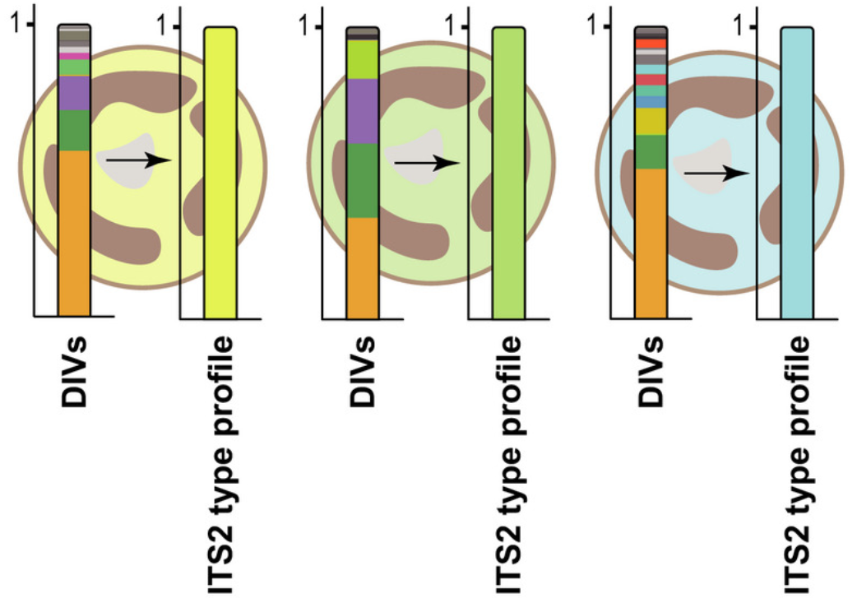
Alternative pipelines for ITS2/16S
ITS2 (for Symbiodiniaceae): Symportal
Dada2 detects more rare/background syms, but does a worse job dealing with intragenomic variation in ITS2 sequences
James’s rec: Do BOTH symportal and dada2 for ITS2
Notes:
https://www.ncbi.nlm.nih.gov/pmc/articles/PMC6964864/
https://onlinelibrary.wiley.com/doi/full/10.1111/1755-0998.13004
A single Symbiodiniaceae cell usually contains hundreds to thousands of rRNA gene copies (Arif et al., 2014; LaJeunesse, 2002; Thornhill, Lajeunesse, & Santos, 2007). On the one hand, diversity of ITS2 sequences can come from sequence variations among these gene copies, giving rise to intragenomic diversity.

Slide 5
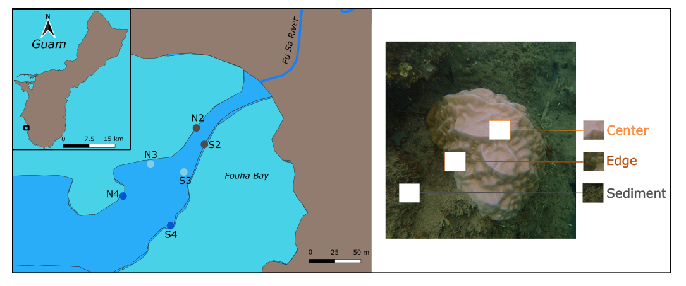
Some cool downstream analyses
Notes:
https://www.ncbi.nlm.nih.gov/pmc/articles/PMC6964864/
https://onlinelibrary.wiley.com/doi/full/10.1111/1755-0998.13004
A single Symbiodiniaceae cell usually contains hundreds to thousands of rRNA gene copies (Arif et al., 2014; LaJeunesse, 2002; Thornhill, Lajeunesse, & Santos, 2007). On the one hand, diversity of ITS2 sequences can come from sequence variations among these gene copies, giving rise to intragenomic diversity.

Slide 6
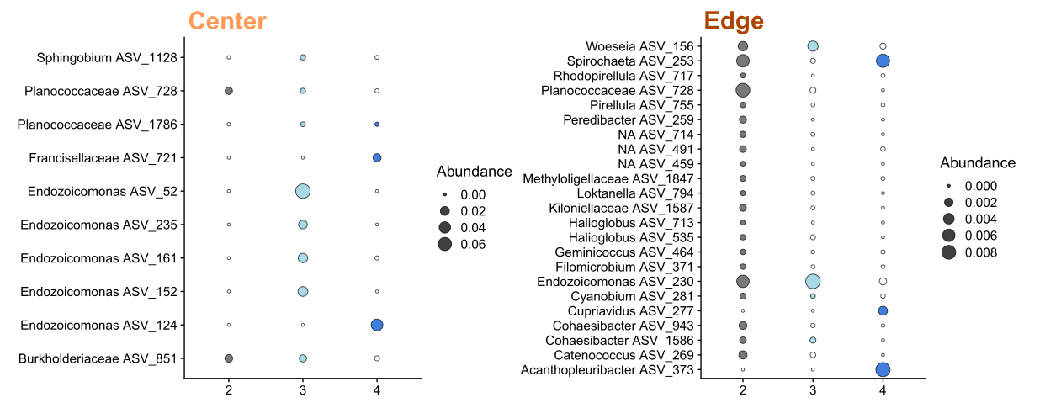
Some cool downstream analyses
Indicator species
Notes:
https://www.ncbi.nlm.nih.gov/pmc/articles/PMC6964864/
https://onlinelibrary.wiley.com/doi/full/10.1111/1755-0998.13004
A single Symbiodiniaceae cell usually contains hundreds to thousands of rRNA gene copies (Arif et al., 2014; LaJeunesse, 2002; Thornhill, Lajeunesse, & Santos, 2007). On the one hand, diversity of ITS2 sequences can come from sequence variations among these gene copies, giving rise to intragenomic diversity.

Slide 7
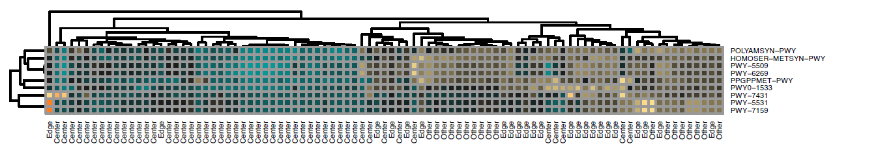
Some cool downstream analyses
Indicator species
Notes:
https://www.ncbi.nlm.nih.gov/pmc/articles/PMC6964864/
https://onlinelibrary.wiley.com/doi/full/10.1111/1755-0998.13004
A single Symbiodiniaceae cell usually contains hundreds to thousands of rRNA gene copies (Arif et al., 2014; LaJeunesse, 2002; Thornhill, Lajeunesse, & Santos, 2007). On the one hand, diversity of ITS2 sequences can come from sequence variations among these gene copies, giving rise to intragenomic diversity.

Slide 8
Other resources
Nicola Kriefall’s github
https://github.com/Nicfall/moorea_holobiont
Dada2 tutorial and github https://benjjneb.github.io/dada2/index.html
Kate Quigley, Todd LaJeunesse, Ben Hume, Mark Warner, John Parkinson
Me!
Notes:
https://www.ncbi.nlm.nih.gov/pmc/articles/PMC6964864/
https://onlinelibrary.wiley.com/doi/full/10.1111/1755-0998.13004
A single Symbiodiniaceae cell usually contains hundreds to thousands of rRNA gene copies (Arif et al., 2014; LaJeunesse, 2002; Thornhill, Lajeunesse, & Santos, 2007). On the one hand, diversity of ITS2 sequences can come from sequence variations among these gene copies, giving rise to intragenomic diversity.

